Slide 1
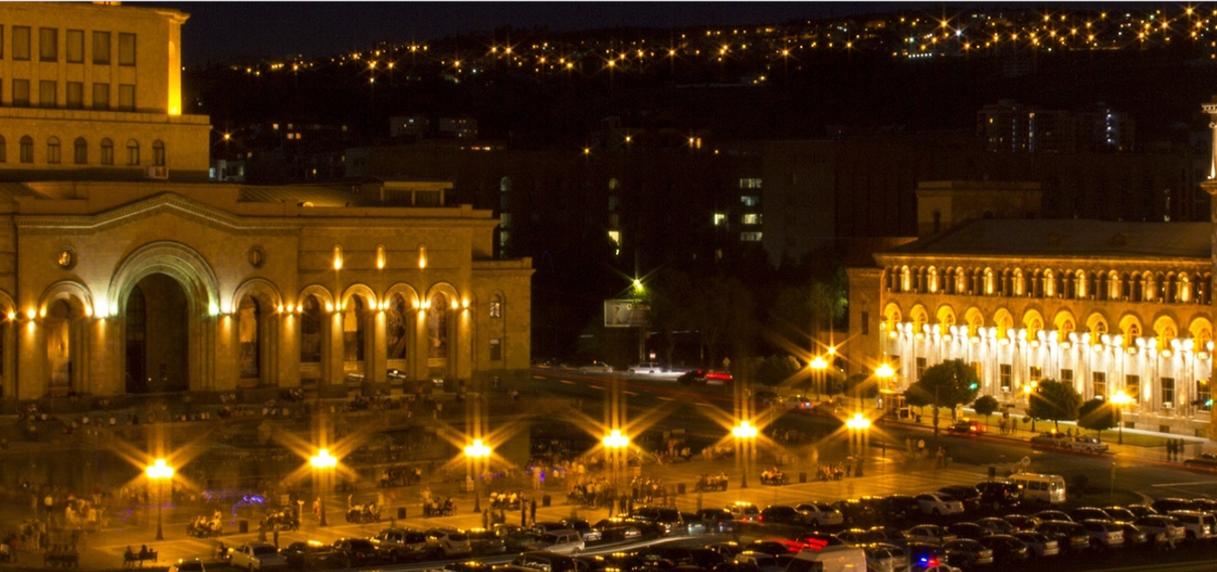
Capstone Project - The Battle of Neighborhoods (Week 2)
Identifying the best location for a new restaurant in Yerevan.

Slide 2
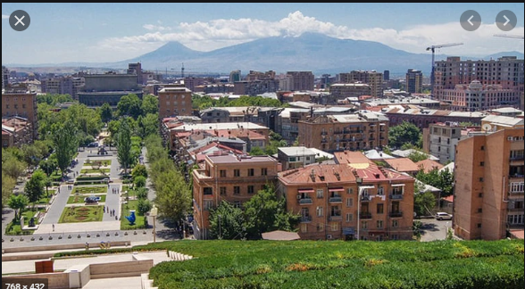
Introduction: Business Problem
Yerevan is the capital and largest city of Armenia. It is the administrative, cultural, and industrial centre of the country. With the growth of the Armenian economy, Yerevan has undergone major transformation. Much construction has been done throughout the city since the early 2000s, and retail outlets such as restaurants, shops, and street cafés, which were rare during Soviet times, have multiplied.
Objective: to identify the best potential districts where a restaurant can be set up.
Target audience: stakeholders who are interested in opening a restaurant in Yerevan.

Slide 3
Data
Factors that will influence the final decision:
Number of existing restaurants in the district.
Number of other places of entertainment, hotels, shops, etc. in the district.
Distance of the district from the city centre.
Data sources will be needed to extract/generate the required information:
List of all districts in Yerevan - https://en.wikipedia.org/wiki/Districts_of_Yerevan
Coordinates of all districts and venues - Google Map data via csv file.
Number of restaurants and their location in every district - Foursquare API - https://developer.foursquare.com

Slide 4
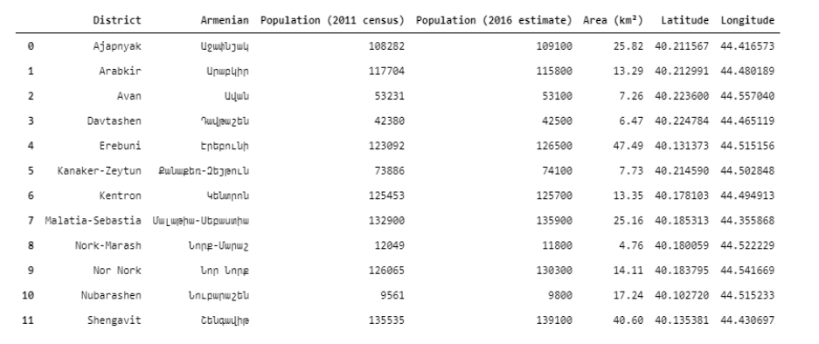
Analysis
A table of all districts in Yerevan is obtained by scraping the corresponding webpage.
The district coordinates are obtained via csv file.

Slide 5
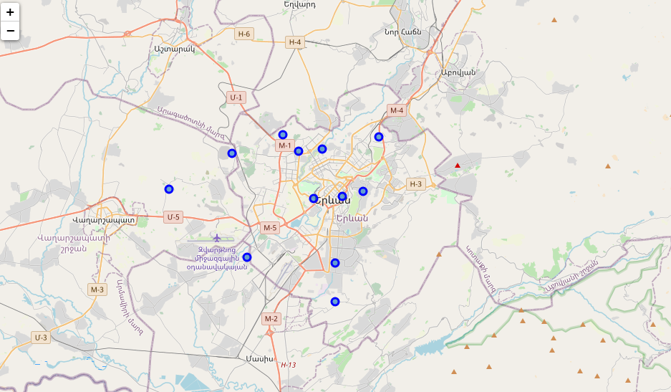
Analysis
A folium map of Yerevan is created:

Slide 6
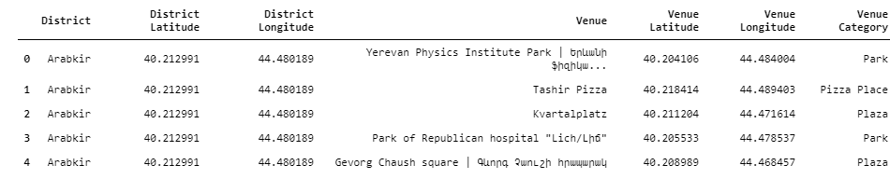
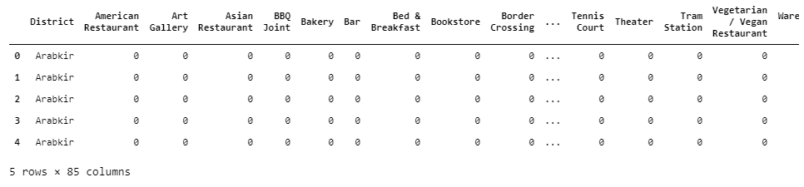
Analysis
Foursquare location data is utilized to obtain nearby venues of all districts, which is loaded into a data frame.
A list of all the districts with 10 or more venues is acquired.
The venues data frame is updated to include only the venues which are in these districts:
The rows in the above data frame are grouped by district, taking the mean of each category’s frequency of occurrence:

Slide 7
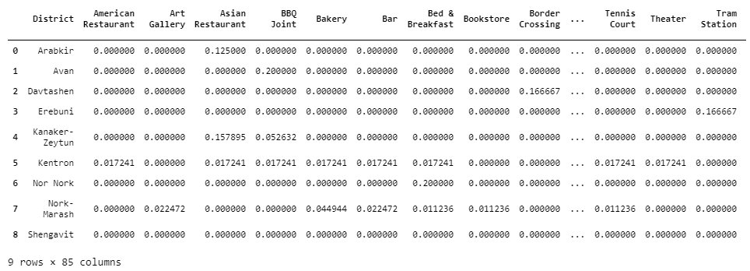
K-Means Clustering
The first step in clustering the districts is to determine the optimal value of K for the dataset. This is carried out using the Silhouette Coefficient Method. It is then discovered that the Silhouette Coefficient is highest when the number of clusters is 2. As a result, the districts shall be grouped into 2 clusters (k=2) using k-means clustering.
A new data frame that includes the cluster, as well as the top 10 venues for each neighbourhood, is created:

Slide 8
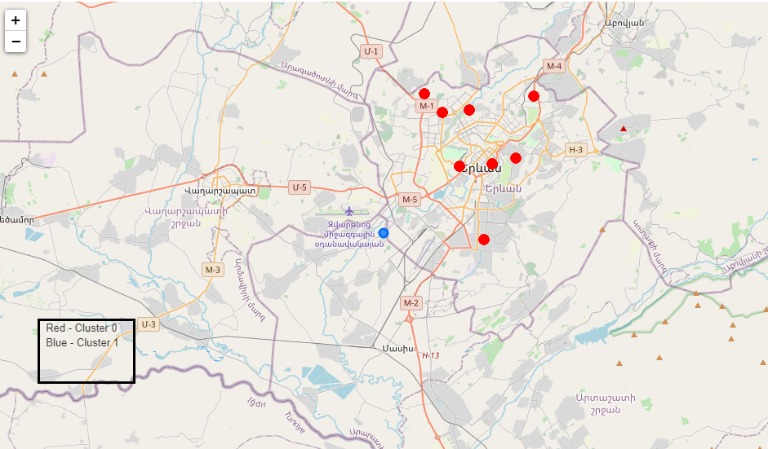
K-Means Clustering
The resulting district clusters are also visualized on a map:

Slide 9
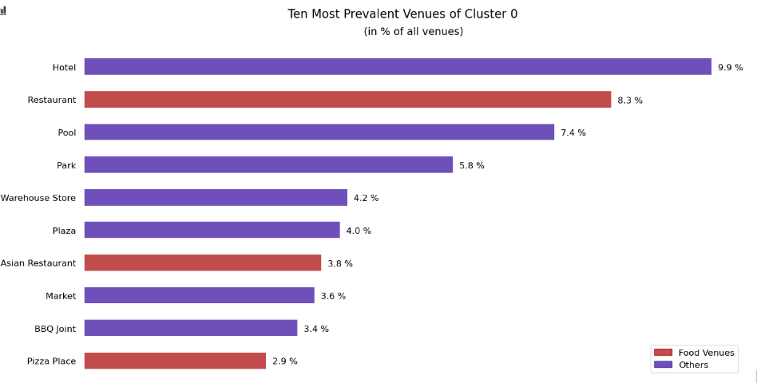
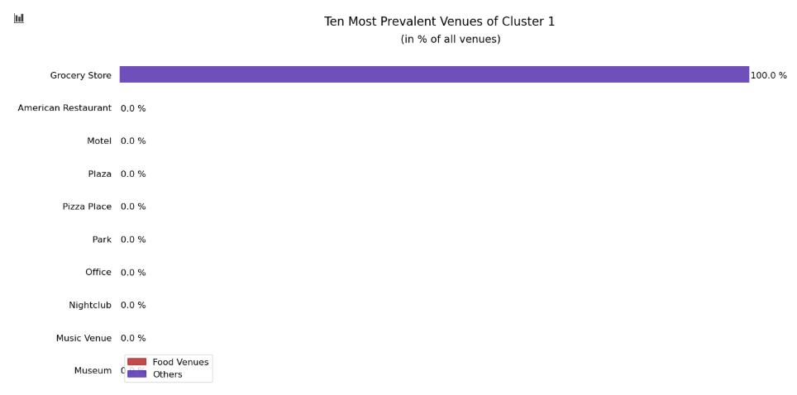
K-Means Clustering
The horizontal bar plots are generated that illustrates the top 10 venues in each cluster:

Slide 10
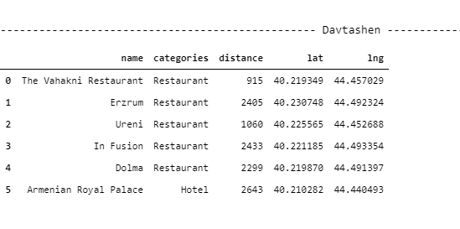
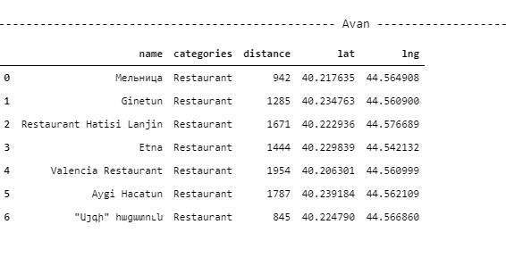
Decision
From the results above it is obvious to investigate Cluster 0 and to eliminate Cluster 1.
Further exploration of the data from Cluster 0 allow to make a decision that districts Avan and Davtashen are closer to the city centre and there is a lack of restaurants in these districts.

Slide 11
Conclusion
The objective of this project was to identify the best potential districts in Yerevan where a restaurant can be set up.
All the required district data was either scraped of the internet or obtained using Google Map data via csv file.
After the districts were visualized on a folium map, their venues were explored using Foursquare location data.
Based on the frequency of occurrences of different venue types, the districts were divided into two groups with the help of k-means clustering.
The clusters were examined and the best one in which a restaurant could be set up was chosen.
The districts were filtered further based on proximity to existing restaurants and distance from the centre of the city.
The analysis brought the number of contenders down to two districts - Avan and Davtashen.
This will only serve as a starting point in the overall investigation since there are a lot of other factors that influence such a decision.

